Slide 1
Lasers
PC2232 Lecture 16
Basic Principles, Characteristics & Applications

Slide 2
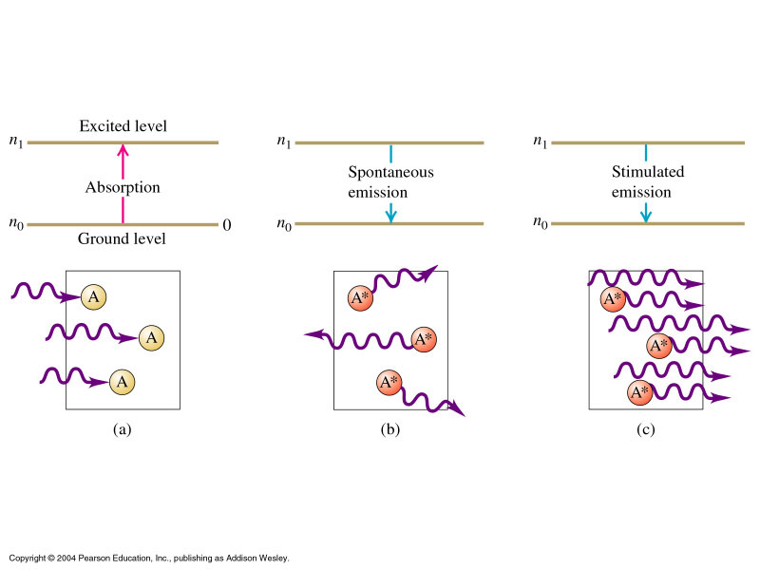

Spontaneous Emission
We have seen in studies of atom spectra that atoms naturally falls from a higher energy level to a lower energy level resulting in an emission of a photon. This process happens randomly both in time and direction. The process happens spontaneously without any stimulus, e.g., in vacuum. This process is known as spontaneous emission.
Excited State
E₂
Ground state
E₁
The frequency of the emitted photon f is given by

Slide 3

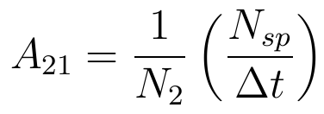

Spontaneous Emission
The process may also be represented by
Excited State
E₂
Ground state
E₁
The number of atoms falling from level 2 to level 1 in time Δt can be written as:
where N₂ is the number of atom in state E₂, and A₂₁ is another proportionality constant.
From above, A₂₁ may also be interpreted as the probability for spontaneous emission.

Slide 4


(Stimulated) Absorption
At the same time, the atom may absorb a photon with the right energy to move from a state of lower energy to one of the higher energy. This process is called stimulated absorption or absorption for short.
If the lower energy state is the ground state, the process can be presented by:
Excited State
E₂
Ground state
E₁
The number of atoms excited (from level 1 to level 2) in time Δt is given by
where N₁ is the number of atom in state E₁, Q is the spectral energy density (i.e., energy per unit frequency range) and B₁₂ is a proportionality constant.

Slide 5


Stimulated Emission
In 1917, Einstein showed that there is a third process – stimulated emission (and went on to show that with this, he could derive the correct expression for the intensity distribution of blackbody radiation obtained by Planck in 1900.)
Excited State
E₂
Ground state
E₁
This process may be represented by:
Similarly, the number of stimulated emission can be written as:

Slide 6
Stimulated Emission
The original photon will stimulate the excited atom to emit a photon that has the same frequency, phase and direction as the original photon. They are coherent with each other. This is a light amplification process as we have two photons after the process whereas initially there was only one.
Adding two photons (or waves) with same phase, the result in light having twice the amplitude. As we have already known, the intensity is proportional to the square of the amplitude and thus the intensity is increased 4-fold!!
Under the right conditions, the two photons could stimulate two more excited atoms to emit – resulting in 4 photons of the same phase and intensity becomes 16 times! Continuing in this manner, we could have an avalanche of photons all in phase. If N photons are produced, intensity increased N² times. Thus laser can have a much higher intensity than incoherent light sources.

Slide 7



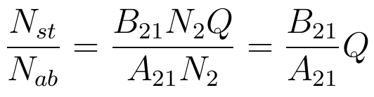
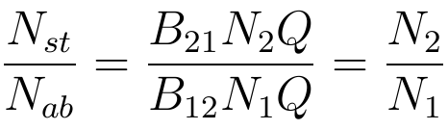
Einstein Coefficients
The constants A₂₁, B₁₂ and B₂₁ were introduced by Einstein and thus commonly known as the Einstein coefficients.
Note that the probability of stimulated transition from 1 to 2 is equal to that from 2 to 1 when subject to the same Q, i.e.,
At thermal equilibrium,
The ratio of various transitions are:

Slide 8
Conditions for Light Amplification
For most transitions between ground state and an excited state, under thermal equilibrium, both ratios are very small and stimulated emission is not a significant process.
To obtain light amplification, N₂ has to be much greater than N₁ – the system cannot be in thermal equilibrium (see next slide).
Also we need to choose transitions where the rate of spontaneous emission is low, i.e., the lifetime of the higher energy state involved should be long. For some atoms, there exist metastable states with lifetime of 10⁻⁶ – 10⁻³ s compared to the usual 10⁻⁹ s for most states. The long lifetime allow the atom to drop to its ground state via stimulated emission instead of its usual spontaneous emission.
It is also not necessary for the lower energy state E₁ to be the ground state. That allows us to deplete this state by allow it the atom to drop to other lower energy states.

Slide 9





Boltzmann distribution
In any system that is in thermal equilibrium, the state with the lower energy will always have a higher population of atoms, i.e., more atoms will be found in the ground state than in any excited state.
This follows from Boltzmann distribution function so that at absolute temperature T, the number of atoms in a state with energy E, is given by:
E_{n}
n
4
where A is a constant determined by the total number of atoms in the system, k = Boltzmann constant = 1.38 × 10⁻²³ J/K.
3
Number of atoms N_{i} in these states
2
1
Hypothetical example

Slide 10
Population Inversion & Pumping
Thus the first problem that the laser pioneers faced was to get more atoms into the higher level compared to the lower level, a condition known as population inversion.
It can be seen that if we substitute N₁ and N₂ into the formula for Boltzmann distribution, with N₂ > N₁, we would obtain a negative T. Some refer to the situation of population inversion as a system with negative temperature. Of course, the proper explanation is that the system is in a non-equilibrium state (thus we should not use the Boltzmann distribution) occurring at ordinary temperature.
To get population inversion, atoms have to be raised continuously to the higher energy state. This process is known as pumping.
Techniques of pumping:
  Optical pumping – light source such as flash discharge tube
  Electrical discharge – electric field causes ionization and put atoms into the desired excited state.
  Direct conversion – of electrical to light energy, e.g., in semiconductor lasers.

Slide 11



Three-Level Pumping Scheme
Use 3 energy levels: 2 lasing levels (E₁, E₂) and 1 pumping level (E₃).
E₃
Pumping level
Rapid
E₂
Metastable state
Slow
E₁
Ground state
Optical Pumping
Lasing Action
Pumping light with frequency f_{p} = (E₃ – E₁)/h brings atoms to E₃.
Spontaneously decay rapidly down to E₁ and E_{2.}
Level E₂ is metastable – atoms in E₂ take a long time to go down to E_{1.}
More atoms were pumped from E₁ to E₃ and drops down to E₁ and E₂.
Atoms accumulated in level E₂ and decays spontaneously very slowly.
Population inversion between E₁ and E₂. Any photon of frequency f_{l} = (E₂ – E₁)/h will trigger the stimulated emission of many atoms from E₂.

Slide 12


Four-Level Pumping Scheme
Similar to 3-level pumping scheme except that the additional level acts as the lower lasing level instead that being served by the ground state.
This allows population inversion to be easily achieved as the lower lasing level is essentially empty. Note that in 3-level pumping scheme, a very high pump power is needed to get as many atoms from the ground state to the upper level.
E₄
Pumping level
E₃
Metastable state
E₂
E₁
Ground state
Optical Pumping
Lasing Action

Slide 13
Optical Resonator
Once population inversion is achieved between two energy levels, any spontaneous emission between these levels could stimulate the other atoms to emit.
To sustain stimulated emission and increase the intensity of light in a cumulative way (and in a definite direction rather than in all random direction), an optical resonator is often used.
100% reflective mirror
Highly (~98%) reflective mirror
Active Medium
Active medium – solid, liquid or gas where light is amplified. Only small fraction of atoms are responsible for the lasing action – called active centres.
Laser light is reflected repeatedly between the two mirrors to stimulate more atoms in active medium to emit and exits through the highly reflective mirror.
http://phet.colorado.edu/en/simulation/lasers

Slide 14



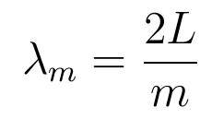
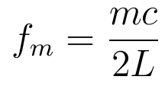

Cavity Modes
Recall that sustain EM waves can only exist as standing waves between two mirrors (with nodes at mirrors).
The wavelengths of these longitudinal cavity modes allowed in the resonator are given by:
where m = 1, 2, 3, … and is called the mode number, typically very large.
Frequency difference between successive mode, i.e., between m^{th} and (m+1)^{th} mode = c/2L.

Slide 15
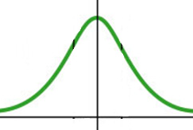

Cavity Modes
The frequency width of typical spontaneous atomic transitions are quite large (e.g., 330 GHz for chromium ion transition), while c/2L is typically 750 MHz for L = 20 cm.
Thus a number of modes may be present in the laser. It is possible to adjust the overall gain (via reflective loss in mirrors, medium, pumping, etc.) so that only one mode is present.
The spectral width of each cavity mode is usually much smaller – in the range of tens of MHz. Thus using the optical resonator also results in an even higher monochromatic light.
Atomic transition
Cavity modes
Frequency
f₀

Slide 16
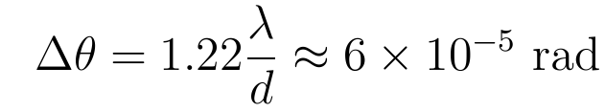
Some Laser Beam Characteristics
Coherence – Waves emitted are in phase over a much longer distance (typically a few km) compared to other light sources such as atomic spectral tubes (typically a few cm).
Directionality – Laser emits light only in a single direction along the optical axis of the system, whereas most light source emit light in all directions.
Divergence – Light from lasers is only diffraction-limited and if the diameter of the front mirror is d ~ 1 cm, then for λ ~ 500 nm, the angular spread of the beam is
Note that for semiconductor lasers, the exit window is quite small, especially in one of the directions and therefore are highly divergent.

Slide 17
Some Laser Beam Characteristics
Intensity – Laser provides very intense light as the beam is concentrated on a very small region. Estimated that a 1-mW laser beam is about 10,000 times that of sunlight on earth surface.
Monochromaticity: As shown earlier, light from lasers is very much more monochromatic than normal light sources.

Slide 18
Some Applications of Lasers
These characteristics of lasers make them one of the most useful recent inventions. Beside scientific and engineering researches, for example in research in atomic physics, they are also used in
Laser welding: melting and joining metallic rods.
Vaporize unwanted material during manufacture of electronic circuits.
Use in surgery to seal small blood vessels.
Detect and destroy enemy’s missiles.
Low power semiconductor laser used in CDs, Blu-rays, laser printers.
High-power lasers used to being about nuclear fusion reactions which may be the ultimate inexhaustible power source for mankind.
Supermarkets – in barcode readers. As pointers, etc, …

Slide 19
Some Applications of Lasers
Application of Laser in Nanoscience: Optical Tweezers, Focused Laser Beam Nanofabrication.
Following this slides will be some slides of research results from my own research group on the applications of laser beam in my research lab.

